Slide 1

SUPPER PROGRAM FOR ASP STAFF
6/11/25

Slide 2
Annual Training
FSD is required to provide annual CACFP supper training to all Food Services (FS) and After School Program (ASP) staff before the start of every school year, new program, and to new employees.
Notes:
TELL: FSD is required to provide annual CACFP supper training to all Food Services (FS) and After School Program (ASP) staff before the start of every school year, implementation of a new program, and to new employees.

Slide 3
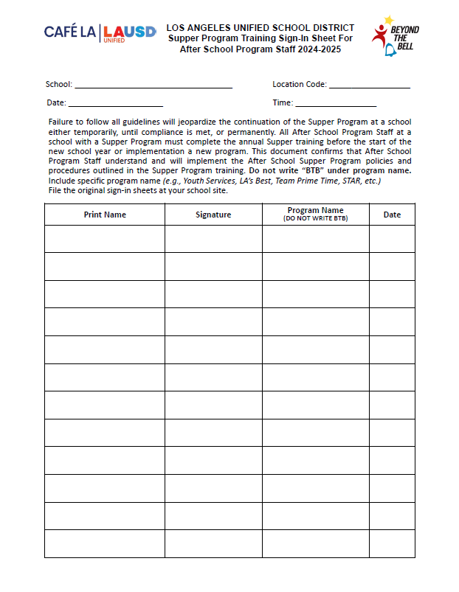
ASP Training Sign in Sheet
ASP staff must be trained prior to working the Hot Supper Program. When completing the ASP Supper Sign-in sheet, program must be specified for each trainee that is signed off.
1st day of school is August 12th
A copy of the “Supper Program Training Sign-in Sheet” will be given to ASP staff for their records
Do not write BTB
Notes:
TELL: This is the Supper Program Training Sign-In Sheet for ASP staff. All ASP staff must be trained prior to working the Hot Supper Program. Ensure that the specific program name is listed in the program name column. Then, file original sign-in sheets at your school site and give a copy to ASP staff for their records.

Slide 4
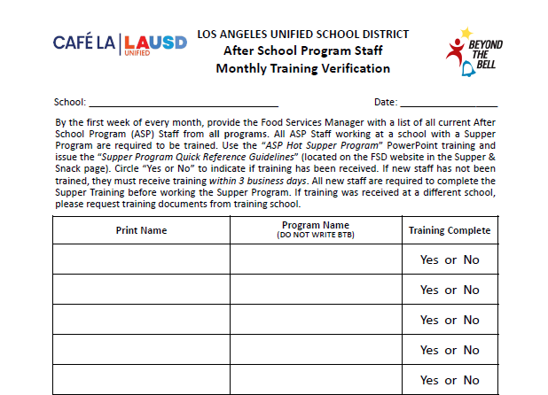
ASP Staff Training
Verification
Happy Elementary
10/18/2025
Due to regular ASP staff turnover, complete the ASP Staff Monthly Training Verification.
  Names will be compared with Supper Program Training Sign-In Sheets.
John Miller
Youth Services
Elizabeth Lee
LA’s Best
George Wilson
LA’s Best
Ann Davis
STAR
Michelle Susette
Boys & Girls Club
Do not write BTB
Notes:
TELL: Due to regular ASP staff turnover, complete the ASP Staff Monthly Training Verification. Upon collection, compare names with Supper Program Training Sign-In Sheets. Next, identify any staff in need of training, then provide training for new staff. Please note that all staff must be trained prior to working in the Hot Supper program.

Slide 5
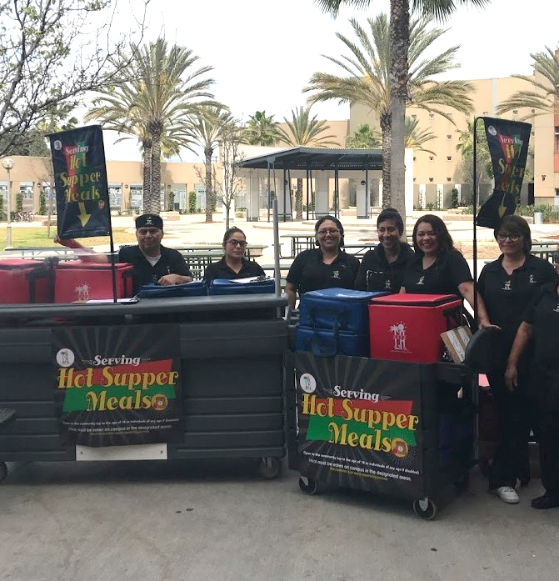
Civil Rights Requirements
All operating sites are required to ensure:
  Equal treatment for all participants
  Good customer service to decrease complaints
  Illegal barriers that prevent participants from receiving benefits are eliminated
  “And Justice for All” poster is displayed where the general public can see and read it
  General public is informed of program availability
    Provide information in the appropriate language
Notes:
TELL: Let’s review the Civil Rights Requirements. All operating sites are required to ensure: equal treatment for all participants, good customer service to decrease complaints, illegal barriers that prevent participants from receiving benefits are eliminated, “And Justice For All” poster is displayed where the general public can see and read it, and that the general public is informed of program availability, if necessary, provide information in the appropriate language.

Slide 6
Early Dismissal Policy
Example: Regular dismissal time is at 2:30pm.
    Meal service times are contingent upon school dismissal.
Cut-Off Time: | Before 1:00 pm | After 1:00 pm
Rule: | Students are served at the regular dismissal time | Students are served at the early dismissal time
Scenario: | Students are dismissed at 12:50pm | Students are dismissed at 1:20pm
Service Time: | Students are served at *2:30pm | Students are served at 1:20pm
    *Exceptions may apply. AFSS approval is required to serve at alternate serving times.
Notes:
TELL: Meal service times are contingent upon school dismissal. Let’s Review the Early Dismissal Policy Chart. Early release days are now categorized into 2 simple categories.
CLICK
TELL: If the students are released before 1pm, Hot supper will be served at the regular dismissal time. For example. Let’s say the regular school dismissal is at 2:30pm.
CLICK
TELL: Let’s explore this scenario. Students are released at 12:50 pm.
CLICK
TELL: According to the Early Dismissal policy, Hot Supper will be served at 2:30 pm. Please note that *Exceptions may apply. AFSS approval is required to serve at alternate serving times.
CLICK
TELL: Let’s look at a different scenario. If the students are released earlier then their regular dismissal, but after 1pm. Then Hot supper will be served Immediately after the early dismissal time.
CLICK
TELL: Let’s explore this scenario. Students are released at 1:20 pm.
CLICK
TELL: According to the Early Dismissal policy, Hot Supper will be served at 1:20 pm.

Slide 7
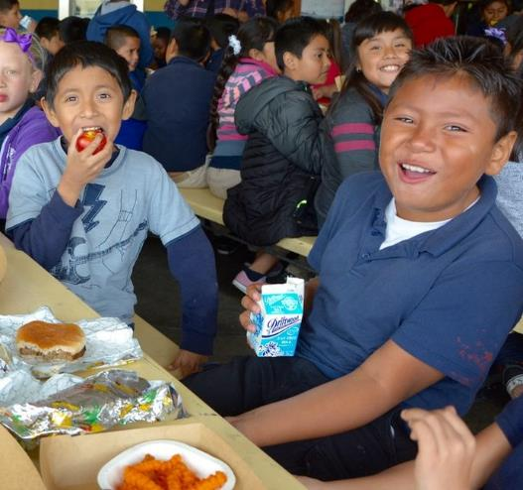
Early Release Students
Service time may be adjusted to accommodate students released before the regular dismissal bell on a regular basis.
These students may include:
  Special Education Students
  Bussed Students
  Other Eligible Programs
Notes:
TELL: Service time may be adjusted to accommodate students released before the regular dismissal bell on a regular basis.
These students include, Special Education students and bussed students, and other eligible programs. Note: Any change in the service time must be included in the Change of Supper Meal Service Form. For example: The school’s dismissal is at 2:30pm, but Special Ed students are released at 2:15pm. Serving time is 2:15-3:00pm.

Slide 8
Chocolate Milk Rule
The CACFP guidelines restricts the serving of chocolate milk to students under the age of six.
  Offer unflavored milk to children under six.
  Children six or older can choose between unflavored or chocolate milk.
To ensure compliance, ask children their age if they appear to be less than six years old.
Notes:
TELL: Now let’s talk about chocolate milk. The CACFP guidelines restricts the serving of chocolate milk to students under the age of six. Children under six must be offered unflavored milk. However, children six or older can choose between unflavored or chocolate milk.

Slide 9





Reimbursable Meals
Supper meal service adheres to OVS guidelines.
3 of the 5 meal components must be selected to complete a reimbursable meal.
Student is not required to take a vegetable or fruit during supper

Slide 10
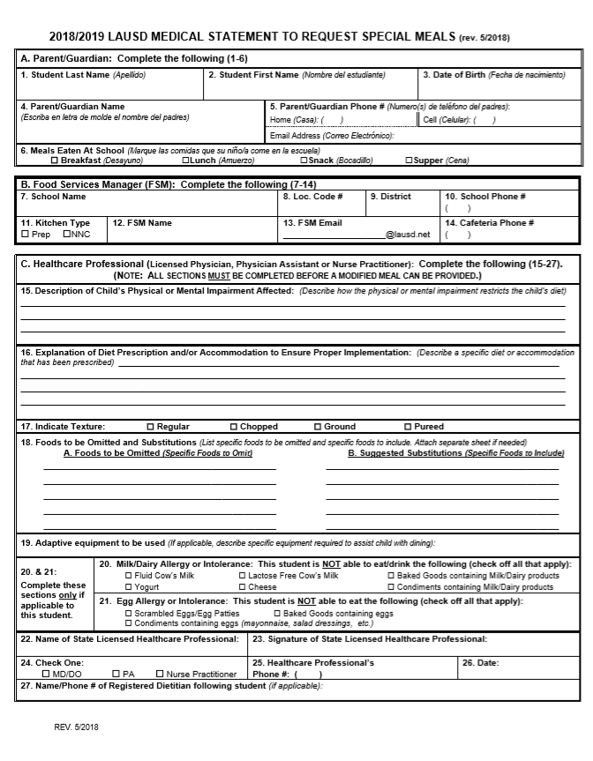
Special Dietary Needs
    Students who require a special meal can complete the “Medical Statement to Request Special Diets form”. ASP will:
    Provide the form to families for completion by the child’s treating physician
    Submit the completed form to the Cafeteria Manager
Notes:
TELL: The Food Services Manager will communicate with FS and ASP staff of any students with food allergies. The Food Service Manager will provide the “Medical Statement to Request Special Diets” to families. The child’s treating physician will need to complete the form. The Food Services Manager will submit the completed “Medical Statement to Request Special Diets” form to the Nutrition Specialists. The manager will make substitutions based on the special diet provided by the Nutrition Specialist.

Slide 11
How to spot a Reimbursable Meal

Slide 12
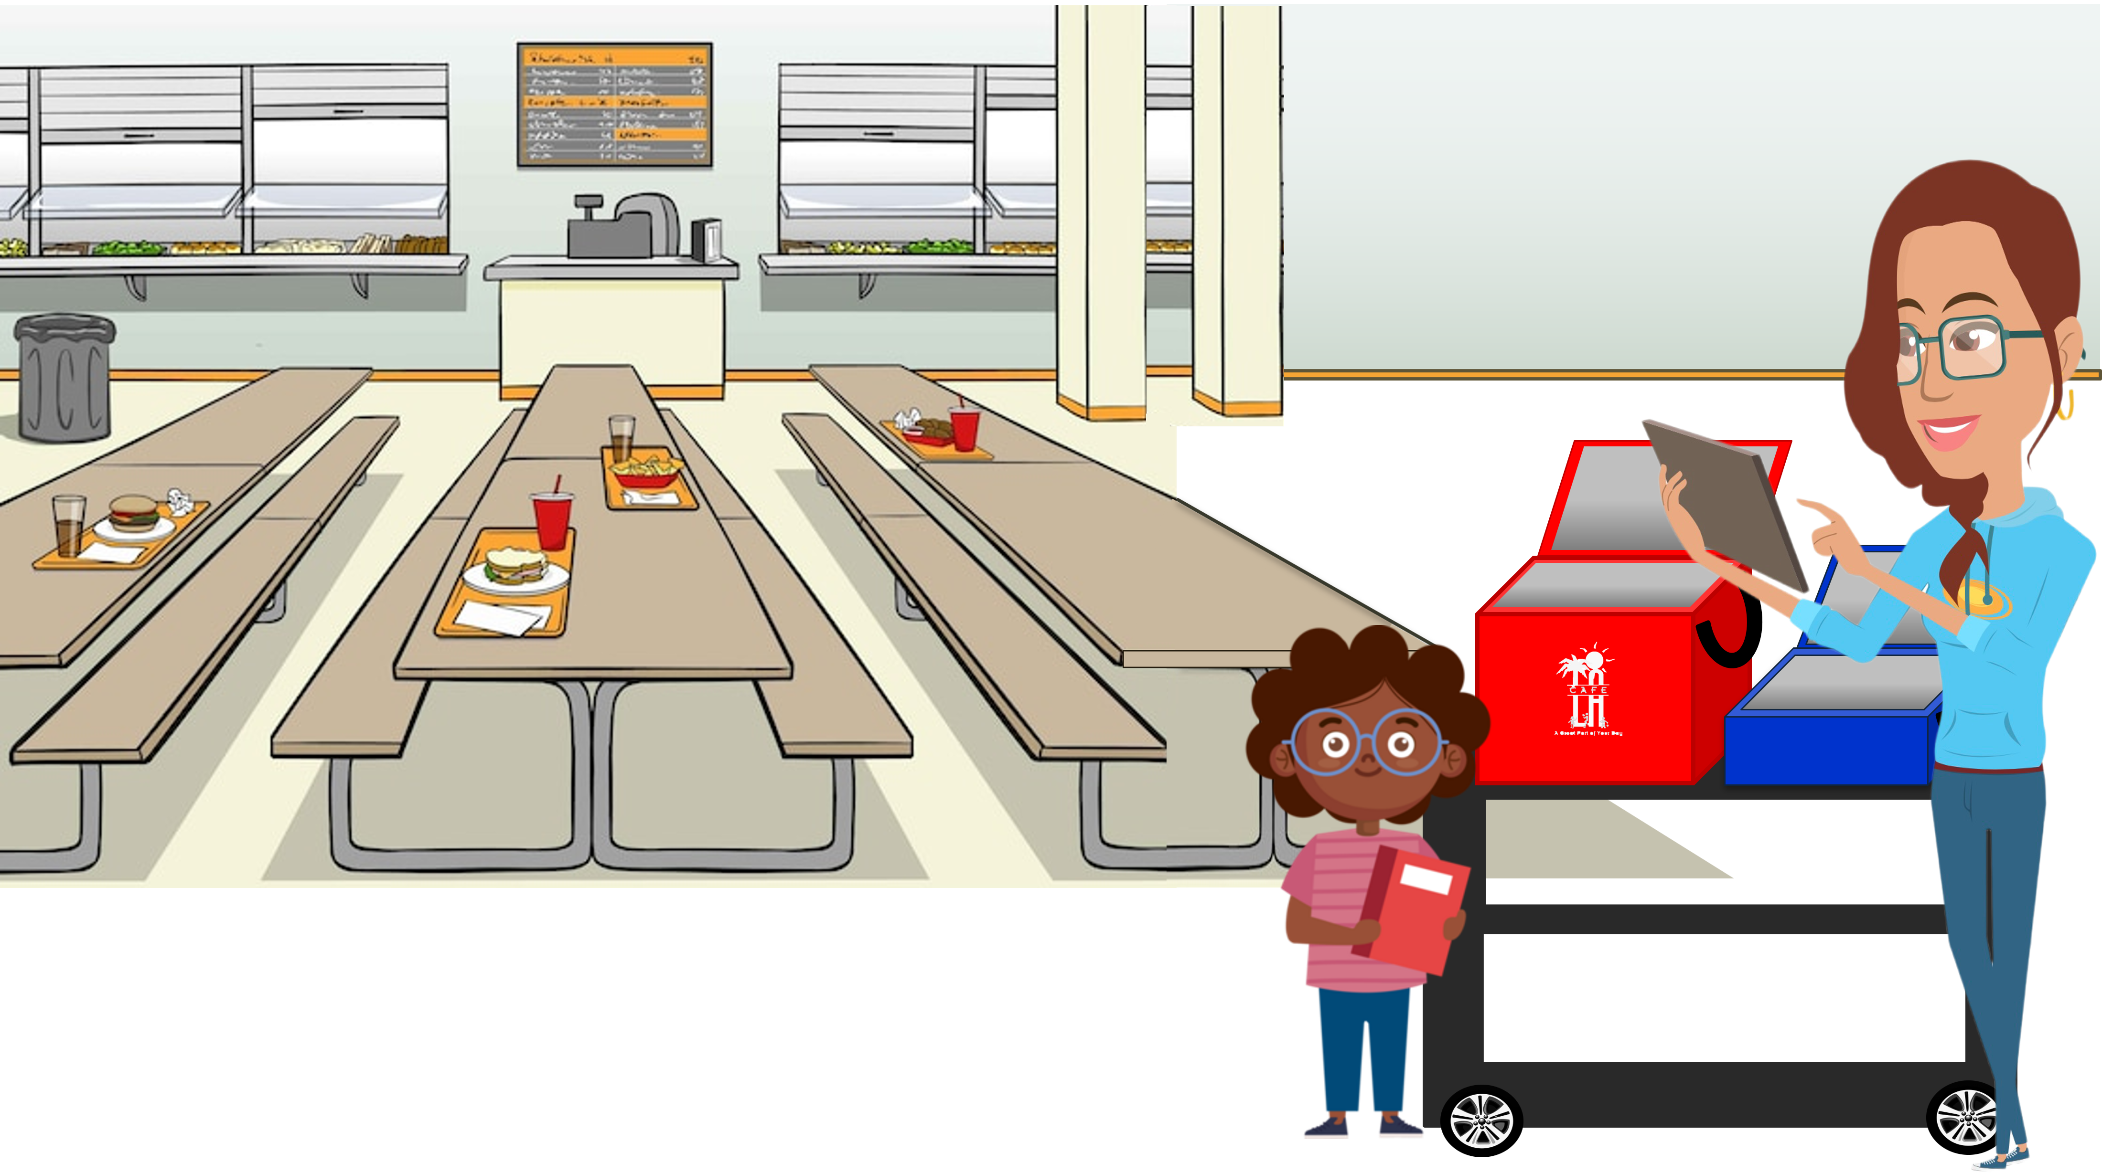

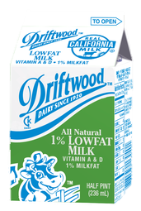
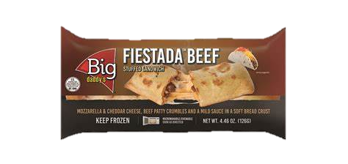


Today’s Menu Items
Is this a reimbursable meal?
1 component food items
2 components entrée

Slide 13
Today’s Menu Items
What about this meal?
1 component food items
2 components entrée

Slide 14
Today’s Menu Items
Last one! Is this a reimbursable meal?
1 component food items
2 components entrée

Slide 15
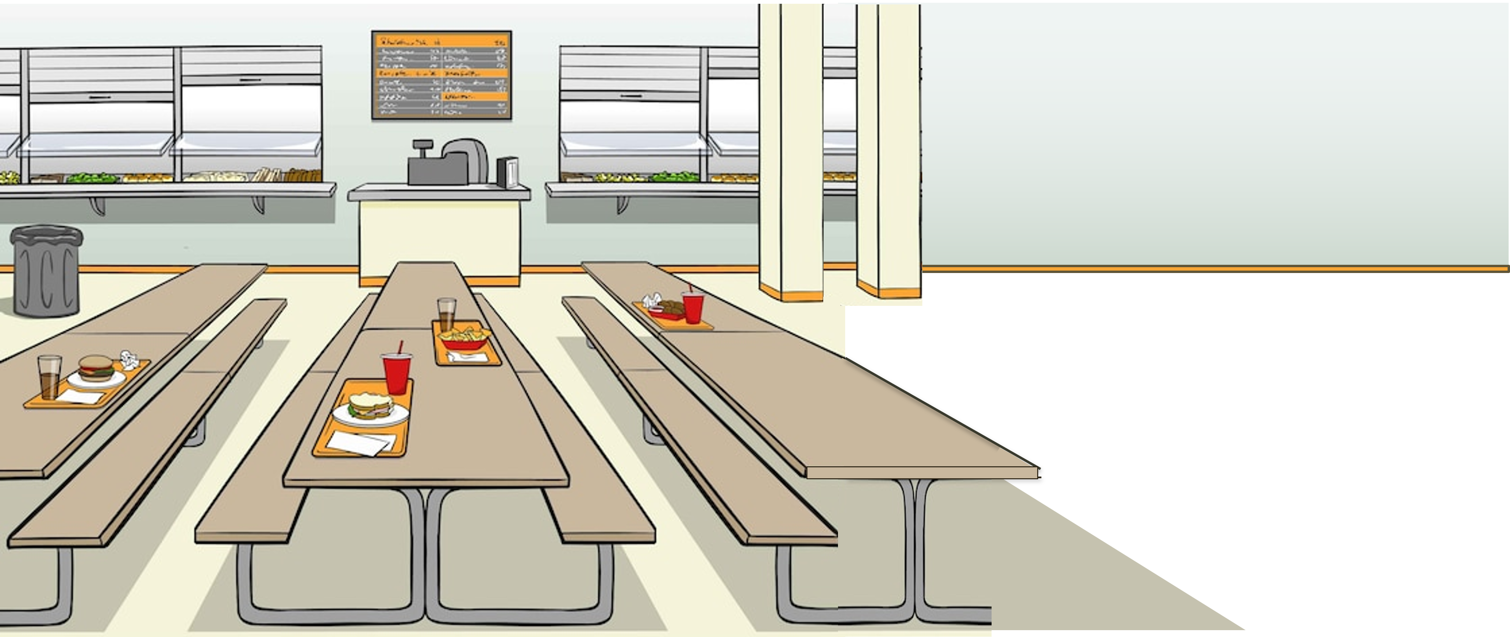

REMINDER
Student is not required to take a vegetable or fruit during supper
3 of the 5 meal components must be selected to complete a reimbursable meal

Slide 16
Supper Cart Set Up
Because of the OVS model, a supper cart and the BIC dolly may need to be used together to serve supper.
Store food items in BIC insulated bags before service
Use BIC dolly to carry additional bags to supper area on campus
Use the shelf space on cart to store 3lb trays and sporkettes
Highly recommended to set up near a lunch table in the designated eating area.

Slide 17
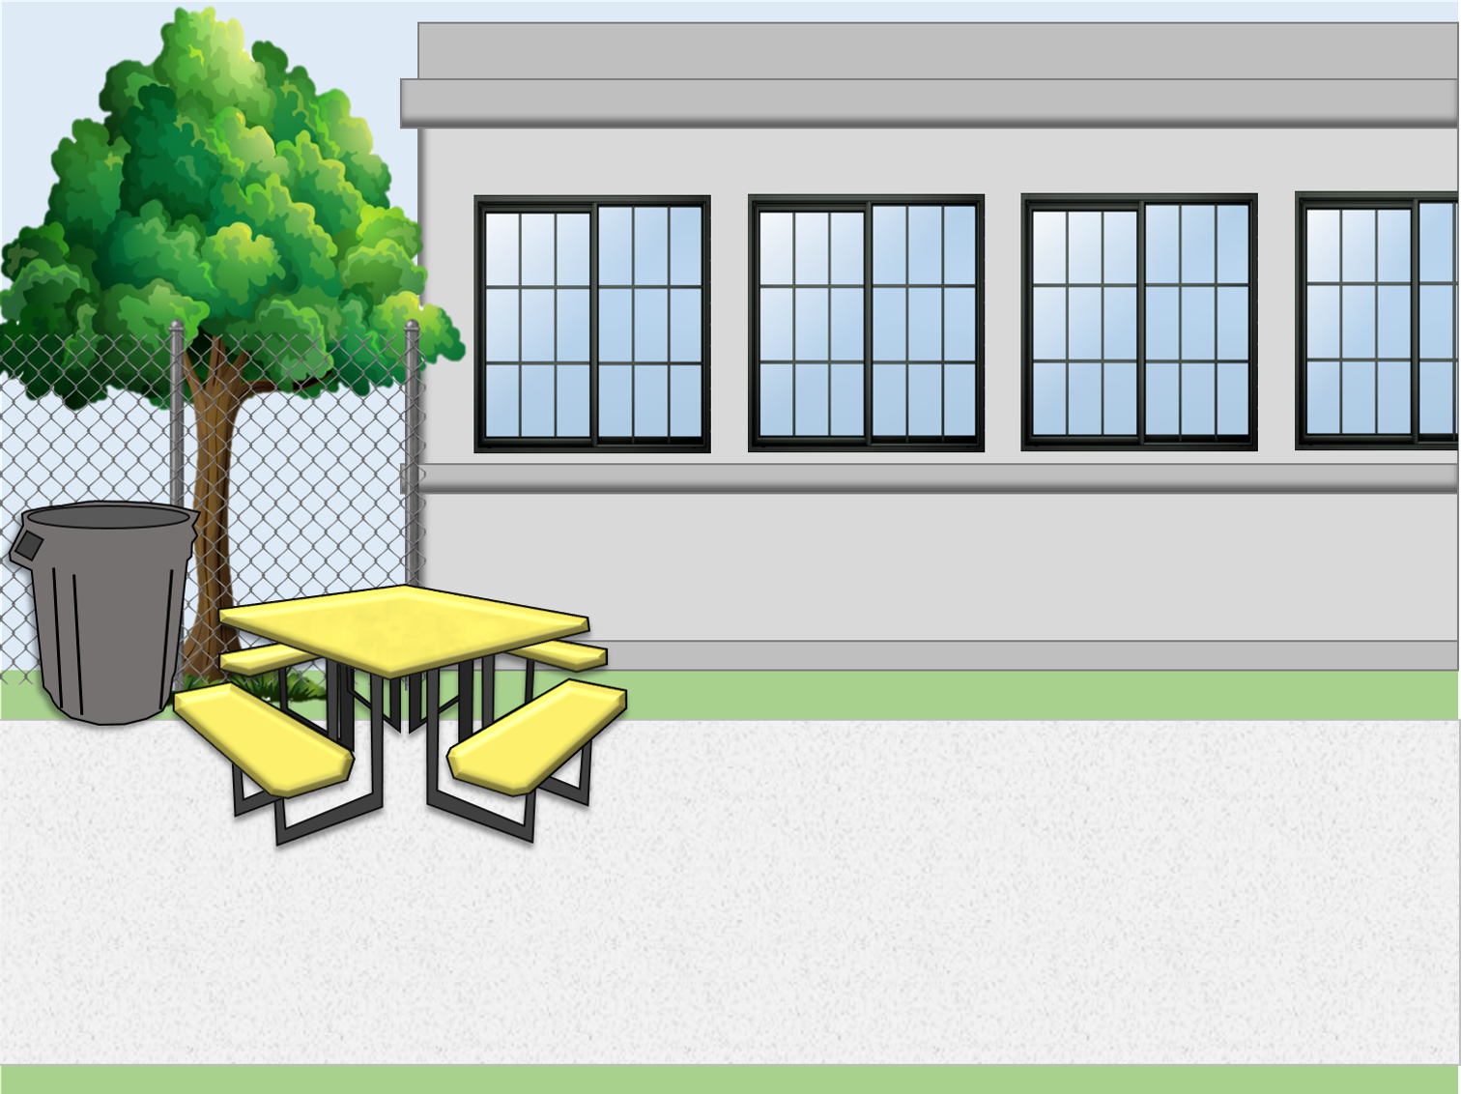

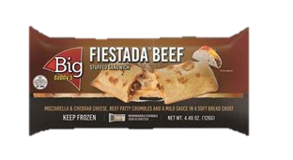
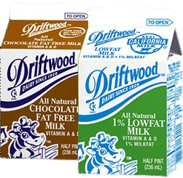

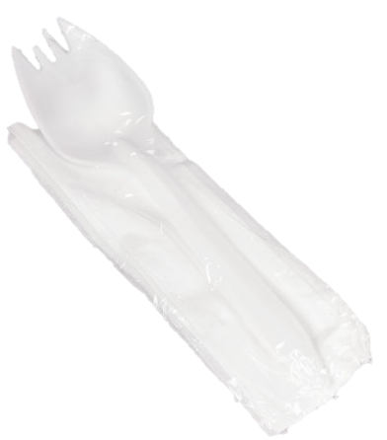
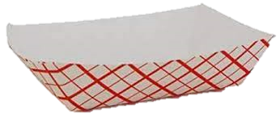

Supper Cart Set Up Example
Your set up may differ according to your participation counts, campus and weekly menu.
Store less popular items in same bag to maximize space.
Do not crush or squeeze food items into bags; use an additional bag.
This model allows for OVS.

Slide 18


Supper Service Example
Staff must ensure reimbursable meals are served BEFORE recording the meals on the ASP/Community Forms. Meals served that are not reimbursable cannot be claimed.
Notes:
“Staff must ensure reimbursable meals are served BEFORE recording the meals on the ASP/Community Forms. Meals served that are not reimbursable cannot be claimed.”

Slide 19
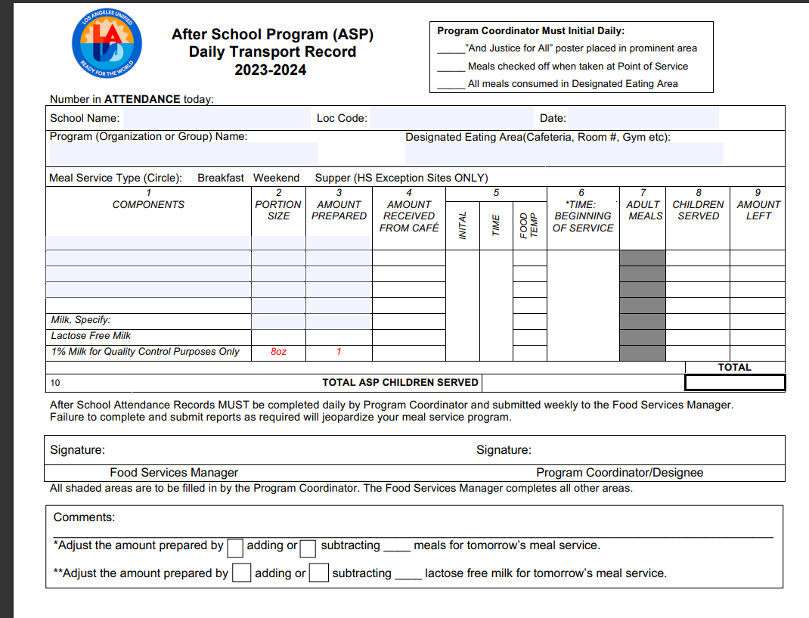
Supper Transport Record
    Supper Transport records must be supplied daily to ASP staff.
    Manager or Food Service Staff will:
    Pre-fill the header with school name, location code, date, ect
    Pre-fill components portion size and amount prepared
Once received ASP staff will then fill amount received, temp each item and document all counts for meals served
ASP coordinator must sign at the end of service before returning transport record
    Manager will sign once record is returned. Signifying all fields have been properly filled

Slide 20

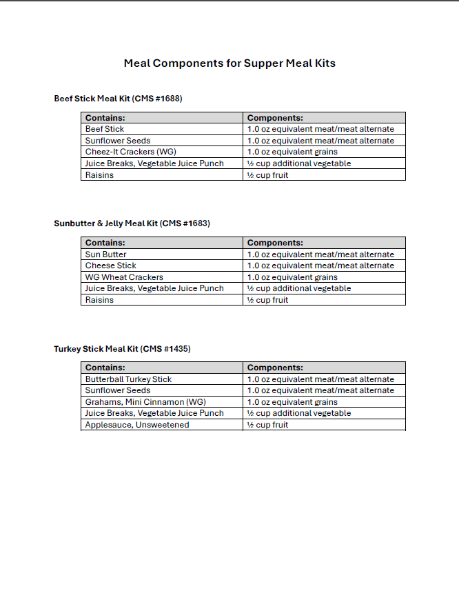
Meal Components for Supper Meal Kits
A menu has been created to detail components of all meal kits served during supper service.
Meal kit will be documented on the Daily Transport Record specifying the meal kits name and CMS number by the FSM.
  FSM will staple the “Meal Components for Supper Meal Kits” menu to the Daily Transport Record
  FSM may write in all components on the Daily Transport Record
Or

Slide 21
Counting and Claiming Forms
ASP Supper Grid Sheet
Community Roster
5-Day
1-Day
5-Day
1-Day
Notes:
TELL: Let’s talk about the Counting and Claiming forms. There are 2 versions of the ASP Supper Grid Sheet and the Community Roster: a 5-day and 1-day. Let’s begin with the ASP Supper Grid Sheet.

Slide 22
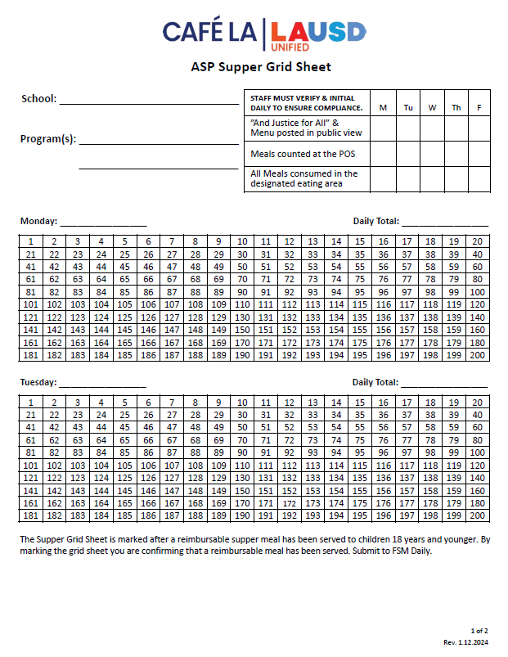
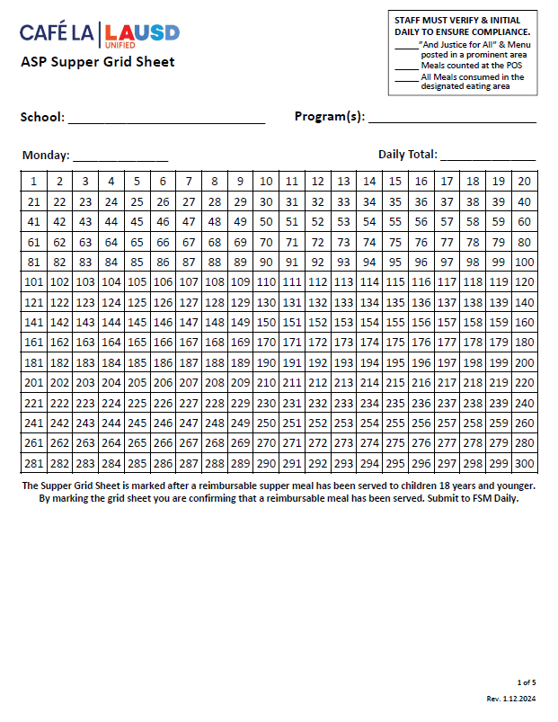
ASP Supper Grid Sheet
These forms record reimbursable meals distributed to the afterschool program students only.
Only trained staff may record meals
Complete heading, date, and record all programs
Verify and initial the compliance box daily
POS staff should focus solely on counting reimbursable meals
Mark each meal in numerical order with a slash or x AFTER a reimbursable meal is served
Record total meal counts daily
Submit to FS Manager daily
5-Day
1-Day
Notes:
TELL: The ASP Supper Grid Sheet records reimbursable meals distributed to the after school program students only. Only trained FS/ASP staff may record the meals distributed. To begin, complete the heading, date, and record all programs. ASP staff must verify and initial the compliance box daily. To claim meals for reimbursement, confirm meal is reimbursable before marking. Then, mark each meal in numerical order with a slash or X. Lastly, record the total meal counts daily. Remember to collect the ASP Supper Grid Sheet daily.

Slide 23
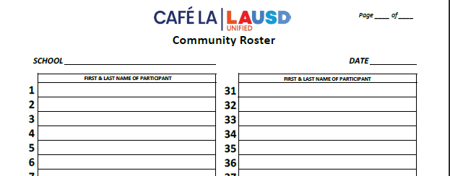
Community Roster
    This form records the attendance and reimbursable meals received by community participants.
      Ensure first & last names are written legibly
      FS or ASP Staff ensures a reimbursable meal is selected before names are recorded
      Young children may be assisted with writing their names
      A community Roster is required at all service locations
      To ensure accuracy in meal accounting, the POS staff should focus solely on counting reimbursable meals
      Submit to FS Manager daily
1 2
Nicole Waterford
Hannah Bankole
Notes:
TELL: The Community Roster records the attendance and reimbursable meals received by community participants. Ensure first and last names are written legibly. Young children may be assisted with writing their names. This form is required at all service locations. Incomplete names listed may be included in the meal count. However, make every effort to obtain the full name at the next supper service. Remember to collect Community Roster daily.

Slide 24
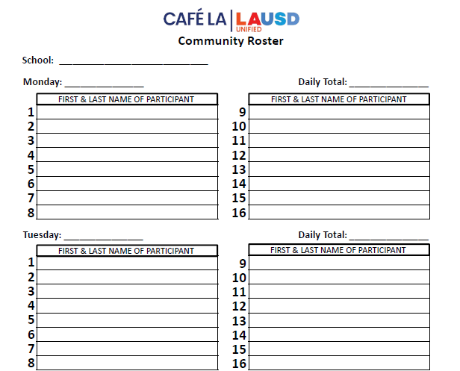

Community Roster Required at ASP Service
Happy El
    ASP staff distributes supper meals to program and community participants.
    However, some ASP Services do not have any community participants.
10/2/2023
0
ZERO PARTICIPANTS
  Is the Community Roster required if
  there are no community participants?
10/3/2023
0
ZERO PARTICIPANTS
Yes!
    Confirm that the count is zero and fill the blank form
      Include the school name and date
      Submit to the Food Services Manager daily
Notes:
TELL: ASP staff distributes supper meals to program and community participants. However, some ASP Services do not have any community participants.
ASK: Is the Community Roster required if there are no community participants?
CLICK
TELL: Yes! Confirm that the count is 0 and file the blank form. Include the school name and date. This blank form must be collected daily.

Slide 25
After School Program Service
Meals are prepared by Food Services Staff; FS Staff then transports ASP supper meals to the ASP staff just before service
ASP Staff distributes meals to program students & assists with serving participants from the community for the first ten minutes of service.
Meals are consumed in the designated eating area. ASP staff assist with ensuring no food leaves the campus.
Meal service begins immediately after the dismissal bell rings, and lasts for 30 minutes.
ASP Supper Grid Sheet & Community Roster are required at the point of service.
ASP Staff ensures reimbursable meal is received before placing an "x" on the meal count form.
    *Exceptions may apply. AFSS approval is required to serve at alternate serving times.

Slide 26
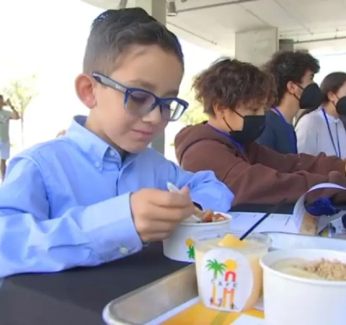
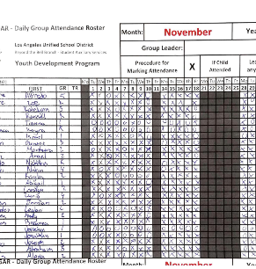
Program Attendance Rosters
    Program attendance rosters record students present in afterschool programs and support the meal counts on the ASP Supper Grid sheet.
    Attendance Rosters must be:
      Greater than or equal to meal counts to support meal claims
      Include student names:
        Can be electronic or manual copies
        Must be submitted weekly
        If rosters are not submitted weekly contact your AFSS
Notes:
TELL: Program Attendance Rosters record students present in afterschool programs and support the meal counts on the ASP Supper Grid sheet. Attendance may be: taken before or after meal service, greater than or equal to meal counts. However, meal counts cannot exceed the attendance. These attendance rosters must be submitted to FSM weekly. As pictured, the correct attendance rosters are taken manually by hand.

Slide 27
Distribute meals to program students and assist community for the first 10 minutes or as needed
Supervise & direct students to the designated eating area
ASP Staff
Make sure program is open to the community
Clean spills, wipe tables, pick up trash & empty bins
Responsibilities
Total daily attendance for all programs and record accurate meal counts
Ensure no food is taken from campus

Slide 28
ASP Staff
WILL NOT
Prepare any food items
Push community carts out to designated areas
Remove hot food from warmers or ovens
Serve participants inside the kitchen area

Slide 29
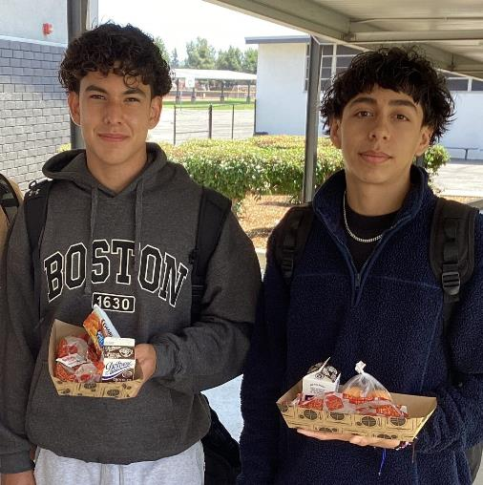
Good Nutrition
All Day Long
    Providing healthy meals shouldn’t stop once the last bell rings. Often times, parents are still at work when their children get out of school.
    Serving hot supper meals allows children to receive three nutritious meals a day to support their growing bodies and learning needs.
Notes:
TELL: Providing healthy meals shouldn’t stop once the last bell rings. Often times, parents are still at work when their children get out of school. Serving hot supper meals allows the children to receive three nutritious meals a day to support their growing bodies and learning needs. Doing this will ensure that together, we are continuing to provide good nutrition all day long.

